Slide 1
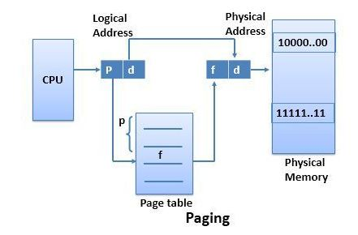


PAGING

Slide 2
Rules:
If we have M bit processor, then logical address will also of M bits long.
Let the size of logical address space is 2^m and page size is 2^n (bytes or words), then the high order (m-n) bits of logical address designate the page number (p) and lower order bits (n) designate the page of offset.
m bits
Page Number Page Offset
m - n
n
Logical Address

Slide 3
Example:
Consider the logical address space of 8 pages of 1024 words mapped onto physical memory of 32 frames
1. How many bits are there in logical address:
Given page size = 1024 words = 1k
Page size = 2^10 ⬄ 2^n so, n = 10
Logical Address space = 8 x 1K = 8K = 2^3 x 2^10 = 2^13 so, m = 13
p = 3 (m – n)
d = 10 (n)
There are 13 bits in logical address space.

Slide 4
2. How many bits are there in physical address
Physical address space = 32 x 1K = 32K = 2^5 x 2^10 = 2^15
There are 15 bits in physical address.

Slide 5
Example:
Given 32-bit processor, page size = 1024 bytes
Find:
1. size of logical address :
32 bits (as 32-bit processor)
2. No. of bits to represent page number and offset:
As page size = 1024 bytes = 2^10 (2^n) so, n = 10
No. of bits used to represent page no. = m – n = 32 – 10 = 22 bits
3. Max size of logical address space:
2^32 bytes = 2^2 x 2^30 = 4GBytes
4. Max number of pages in logical address space:
Space = 2^m-n = 2^22 = 2^2 x 2^20 = 4MBytes = 4 Million
5. Max length of page table of a process :
4 M entries (max no. of pages in process)
Note to remember:
1K = 2^10 Bytes
1MB = 1024KB
= 2^10 x 2^10
= 2^20 Bytes
1 GB = 1024 MB
= 2^30 Bytes

Slide 6
Example: Assume a logical address space of 16 pages of 1024 words, each mapped into a physical memory of 32 frames.
No. of bits needed for p =ceiling[ log16] 2^4=4bits
No. of bits needed for f = ceiling[ log32] 2^5=5bits
No. of bits needed for d = 2048bytes =2^11
Logical address size = |p|+|d|=4+11=15bits
Physical address size =|f|+|d|=5+11=16bits
Page Table Size—Page table size = NP * PTES, (assuming a byte size page table entry)
where NP is the number of pages in the process address space and PTES is the page table entry size (equal to |f|)

Slide 7
16-bit logical address
2^16
8K page size
Maximum pages in a process address space =
2^16/8K=8pages
|d| = log2 8K =13bits
|p| = 16-13=3bits

Slide 8
Example:
Logical address = 32-bit
Process address space = 2³² B = 4 GB
Main memory = RAM = 512 MB
Page size = 4K
Maximum pages in a process address space = 2^32/4K=1M
|d| =32-20=12bits
|p| = ceiling[log1M]=20bits
No. of frames = 512MB/4K =128K
|f| = ceiling[log128K]=17bits
Physical address = |f|+|d|=17+12=29bits

